Slide 1



Effects of de-escalation phases on mobility patterns during June 2020 in Spain based on mobile phone data
Jaime Pizarroso Gonzalo

Slide 2
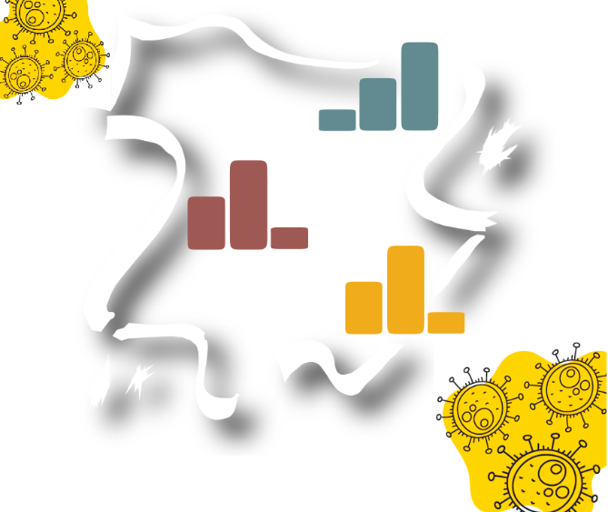
Introduction
Objective
Analyze de-escalate measures effect on mobility patterns in Spain during June 2020.
Motivation
Provide insights into how the virus is affecting people’s movement between different areas of the country.

Slide 3
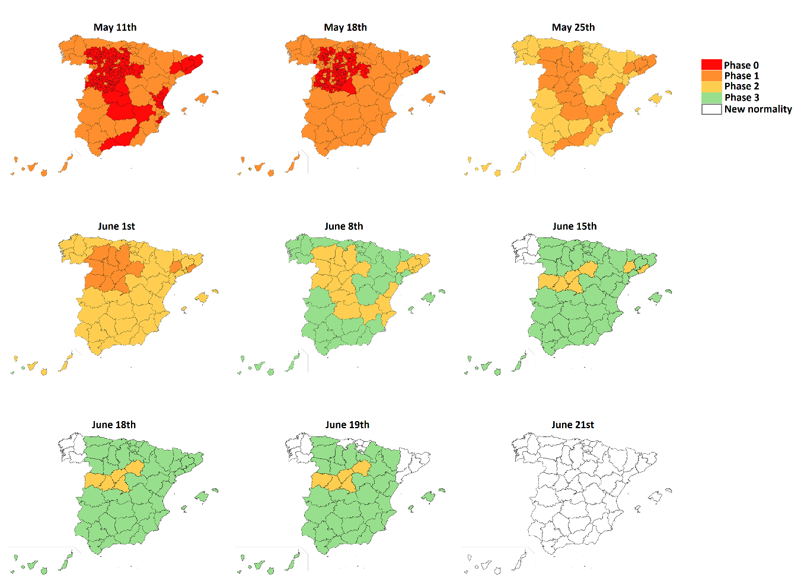
Case study
Study area and phases

Slide 4
Data sources
Mobile phone records
Extract mobility indicators. Requires preprocessing
Data on State of Alarm phases and measures
Phases of each province
Epidemic data
COVID-19 infections and deaths
Geographic data
For building maps.

Slide 5
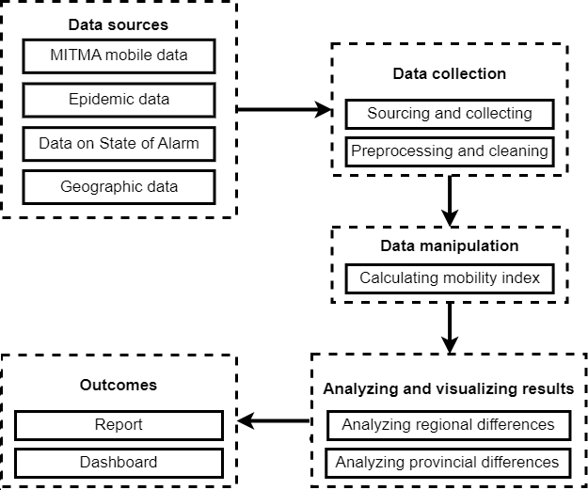
Methodology

Slide 6
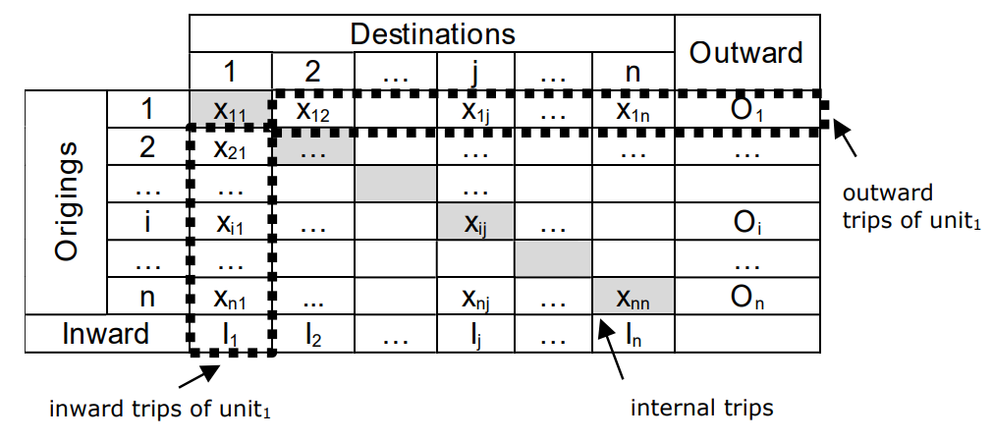
Methodology
Mobility indexes calculated:

Slide 7
Methodology
Study weeks | Dates | Corresponding phase
W0 | 14-20 February | Reference week for normal activity prior to COVID-19, before the state of alarm.
W1 | 4-10 May | Second reference week for normal activity during COVID-19, during the state of alarm.
W2 | 1-7 June | First week of June 2020, where most provinces are in phase 2 and general mobility is not allowed.
W3 | 8-14 June | Second week of June 2020, where most provinces enters phase 3 and general mobility is allowed.
W4 | 15-21 June | Third week of June 2020, where all provinces transition between phase 2 or 3 to new normality phase.
W5 | 22-28 June | Fourth week of June 2020, where all provinces are in new normality phase.

Slide 8
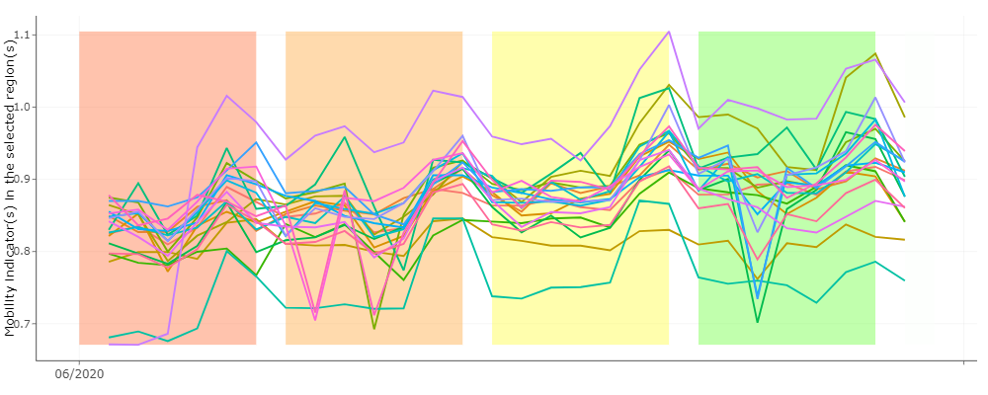
Results
Regional level internal index, compared to baseline week in February:

Slide 9
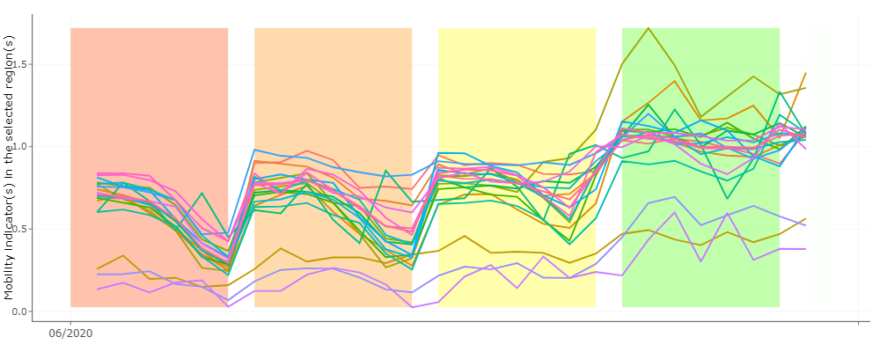
Results
Regional level inward index, compared to baseline week in February:

Slide 10
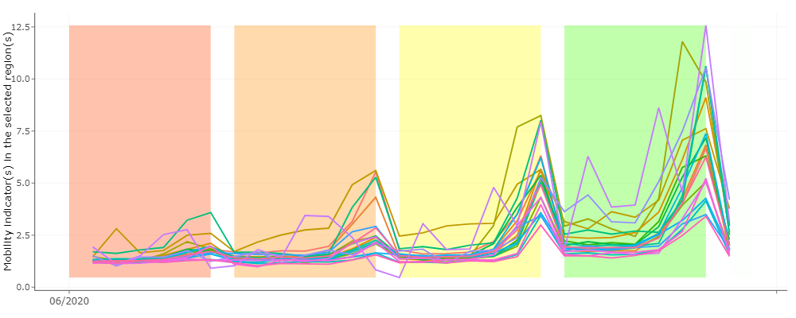
Results
Regional level inward index, compared to baseline week in May:

Slide 11
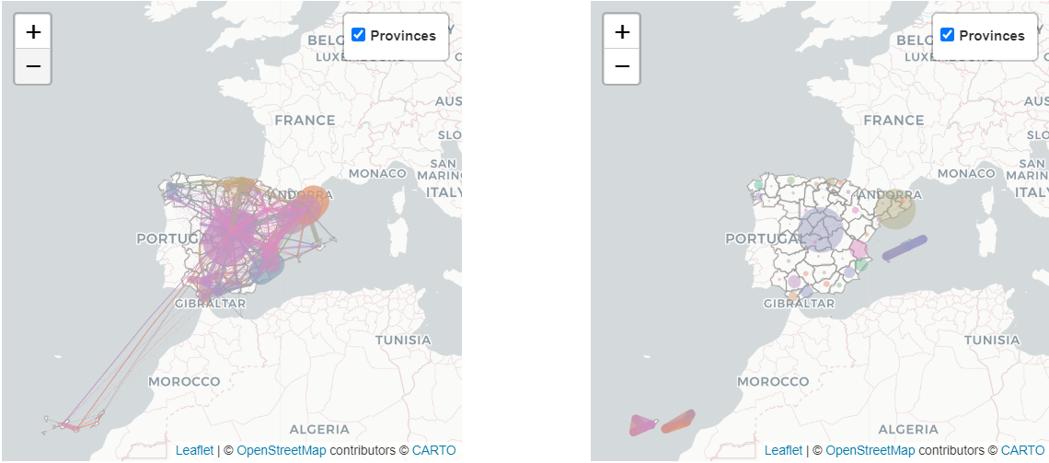
Results
Province level travels, compared to yearly trips in 2017:

Slide 12
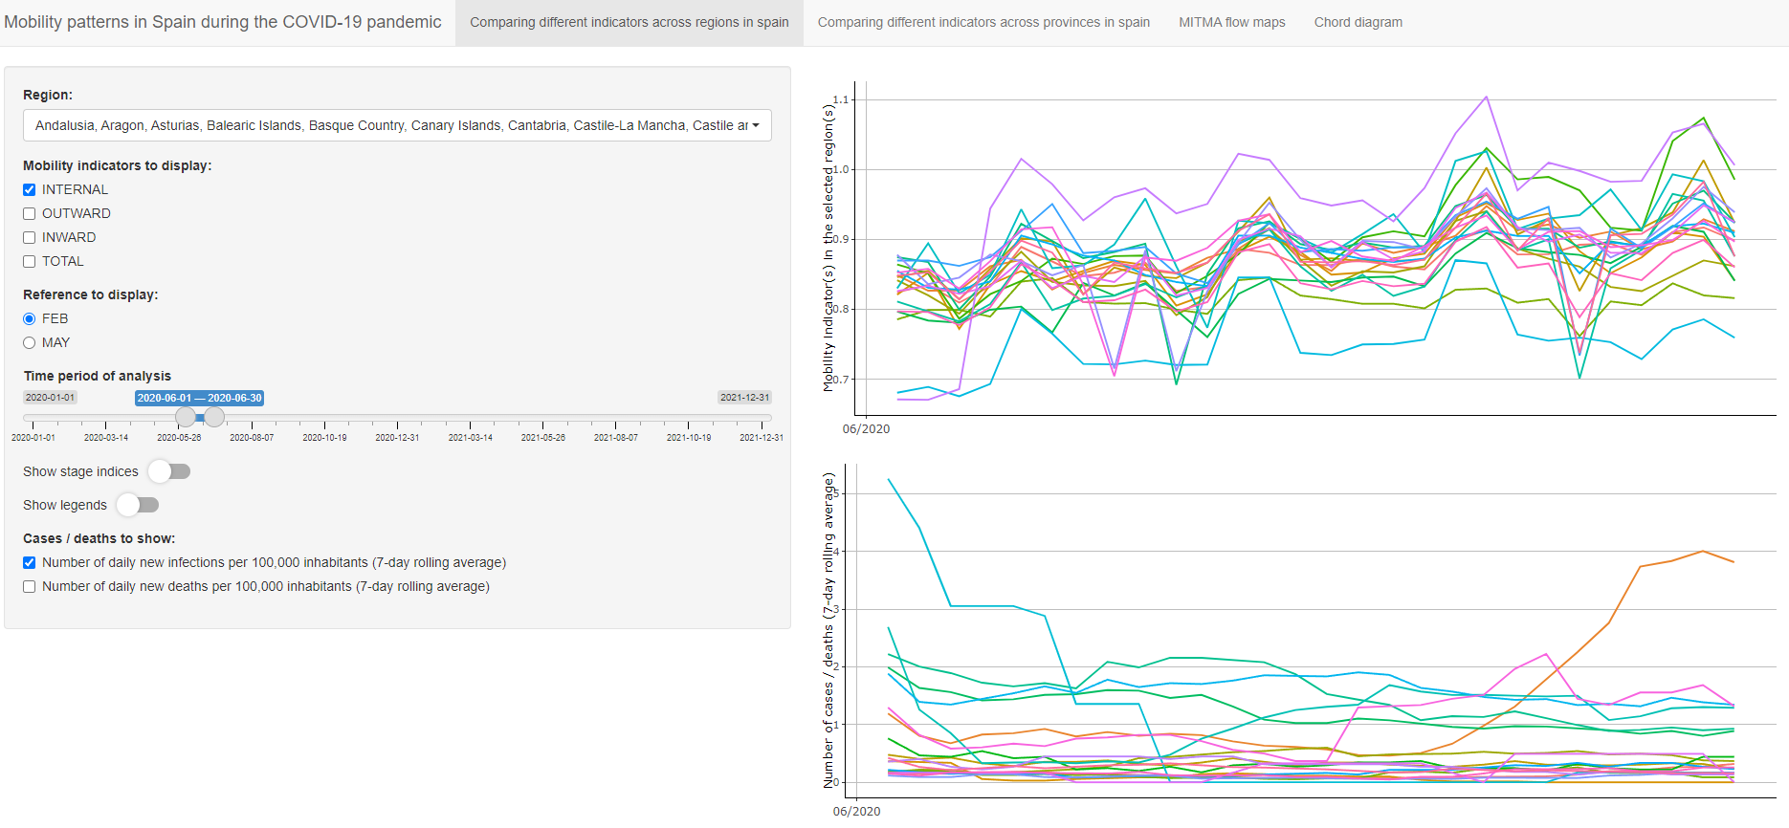
Results
Dashboard:

Slide 13
Conclusions
Online dashboard based have been made available for future research
After most restrictions were lifted, mobility levels returned to 80-90% of the baseline week in February.
Compared to the baseline in May, mobility levels raised to 250-500% at weekends.
Mobility levels might be affected by seasonality.

Slide 14
Future researches
Effect of holidays
Effect of movement restrictions
Use of public vs private transport
Effect of telework and other company policies

Slide 15
Thank you

